Slide 1
Computer Vision and Image Processing
Tirgul 7
Denoising & Bilateral
By Shai Aharon & Moriya Bitton

Slide 2
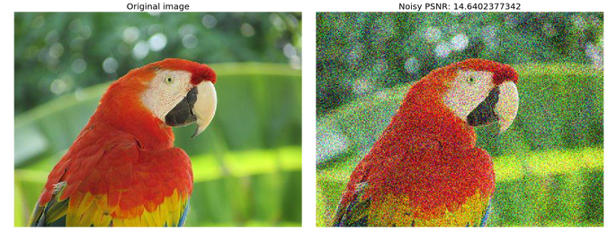
Denoising

Slide 3
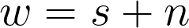
Denoising - Noise models
Additive noise model
Multiplicative noise model

Slide 4
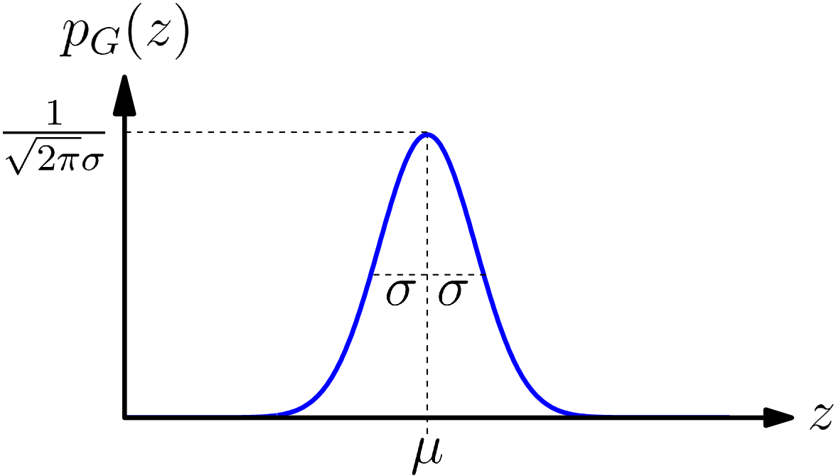
Denoising - Types of noises
Gaussian Noise
Is evenly distributed over the signal. This means that each pixel in the noisy image is the sum of the true pixel value and a random Gaussian distributed noise value.
Can happen due to sensor noises.

Slide 5
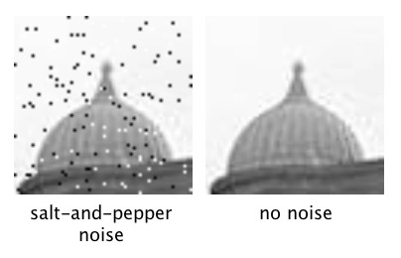
Denoising - Types of noises
Impulse Noise
The impulse noise is of two types, Fixed value and random value:
Fixed value (salt and pepper noise)
It is generally caused due to errors in transmission, either 0 or 1.
The corrupted pixels are set alternatively to a minimum or to maximum values giving the image Salt and Pepper
Random value
Can have any value between 0 and 1, hence its removal is very difficult.

Slide 6
Denoising - Methods
Spatial Domain
Frequency Domain
Non-Linear
Linear
LPF on Fourier Transform
Median Filter
Mean Filter (Box Filter)
Weighted Median Filter (Gaussian Filter)

Slide 7
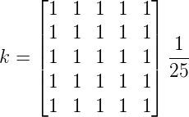
Denoising - Mean Filtering
Replaces the center value of the window with the average values of its all nearest pixels values together with itself.
Advantage:
Easy to implement
Used to remove the impulse and Gaussian noise.
Disadvantage:
It does not preserve details of the image. Some subtle details are removed from the image (Edges).

Slide 8
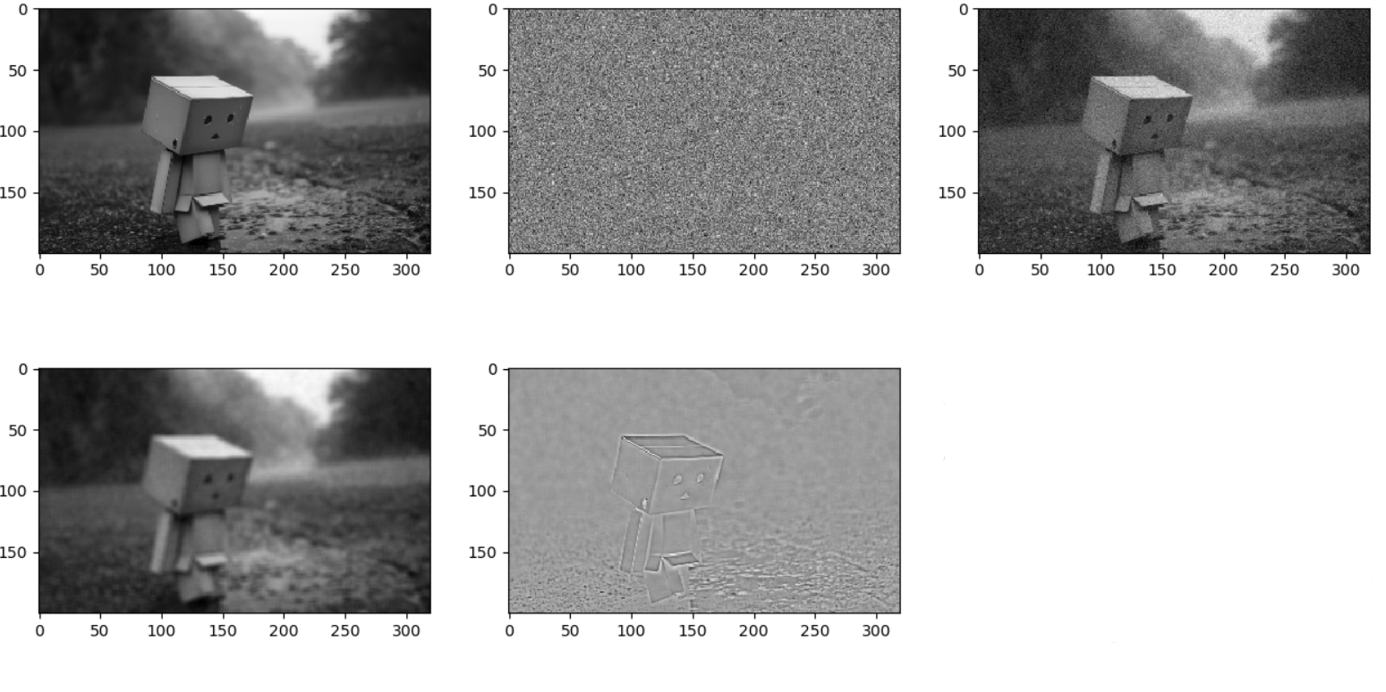
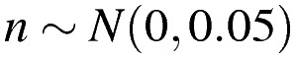
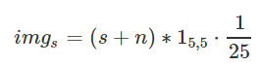
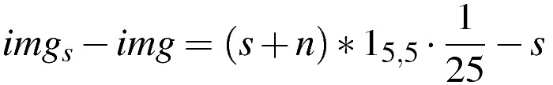
Denoising - Mean Filtering
Original
Noise
Image + noise
Smoothed Image
Smoothed - original image
Notice the strong response around the edges

Slide 9
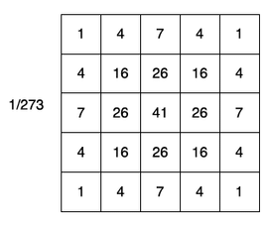
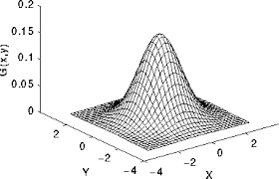
Denoising - Weighted Mean Filtering
Replaces the center value of the window with the weighted average values of its all nearest pixels values together with itself.
Advantage:
Preserves the edges better
Still fast and easy to implement
Disadvantage:
Not perfect

Slide 10
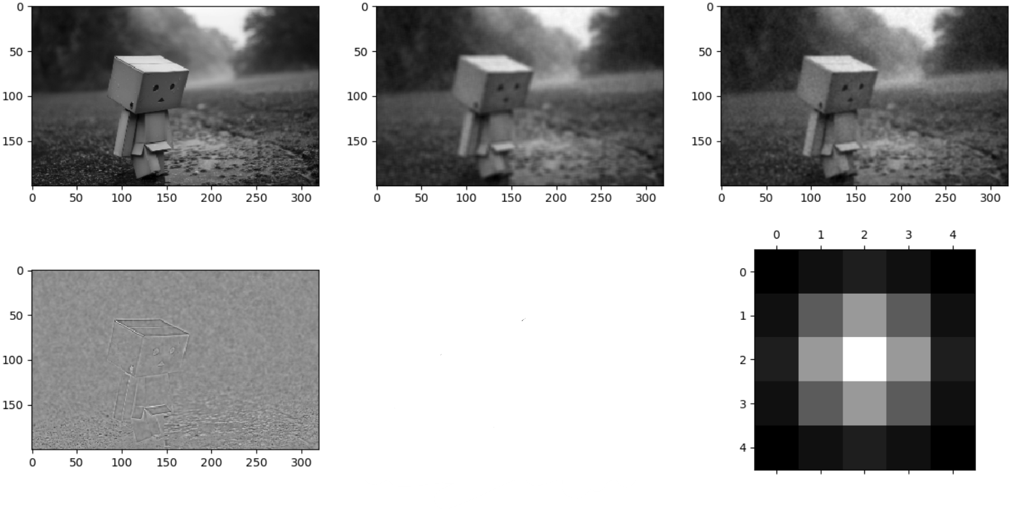
Denoising - Weighted Mean Filtering
Mean
Weighted Mean
MAE Mean: 0.0219
MAE Weighted Mean: 0.0193
It’s better, but still damages the edges

Slide 11
Bi-Lateral Filtering
Up until now, we looked at smoothing methods that take into account the neighbor’s colors based on distance only in a uniform (Box-Filter) or semi-uniform (Gaussian Filter) manner.
Fails around edges, where close pixels have very different values
Bi-Lateral Filter uses Gaussian filter, but “Gives” extra weight to pixels which are similar to the pivot (center) pixel.
How?

Slide 12
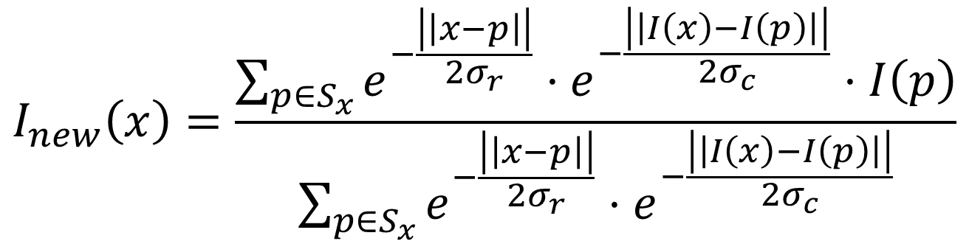
Bi-Lateral Filtering
$$I_{new}\left(x\right)=\frac{\sum_{p∈S_{x}}{e^{−\frac{\left|\left|x−p\right|\right|}{2σ_{r}}}}⋅e^{−\frac{\left|\left|I\left(x\right)−I\left(p\right)\right|\right|}{2σ_{c}}}⋅I\left(p\right)}{\sum_{p∈S_{x}}{e^{−\frac{\left|\left|x−p\right|\right|}{2σ_{r}}}}⋅e^{−\frac{\left|\left|I\left(x\right)−I\left(p\right)\right|\right|}{2σ_{c}}}}$$

Slide 13
Bi-Lateral Filtering
Gaussian smoothing
$$I_{new}\left(x\right)=\frac{\sum_{p∈S_{x}}{e^{−\frac{\left|\left|x−p\right|\right|}{2σ_{r}}}}⋅e^{−\frac{\left|\left|I\left(x\right)−I\left(p\right)\right|\right|}{2σ_{c}}}⋅I\left(p\right)}{\sum_{p∈S_{x}}{e^{−\frac{\left|\left|x−p\right|\right|}{2σ_{r}}}}⋅e^{−\frac{\left|\left|I\left(x\right)−I\left(p\right)\right|\right|}{2σ_{c}}}}$$

Slide 14
Bi-Lateral Filtering
Color similarity factor
Gaussian smoothing
$$I_{new}\left(x\right)=\frac{\sum_{p∈S_{x}}{e^{−\frac{\left|\left|x−p\right|\right|}{2σ_{r}}}}⋅e^{−\frac{\left|\left|I\left(x\right)−I\left(p\right)\right|\right|}{2σ_{c}}}⋅I\left(p\right)}{\sum_{p∈S_{x}}{e^{−\frac{\left|\left|x−p\right|\right|}{2σ_{r}}}}⋅e^{−\frac{\left|\left|I\left(x\right)−I\left(p\right)\right|\right|}{2σ_{c}}}}$$

Slide 15
Bi-Lateral Filtering
Color similarity factor
Gaussian smoothing
$$I_{new}\left(x\right)=\frac{\sum_{p∈S_{x}}{e^{−\frac{\left|\left|x−p\right|\right|}{2σ_{r}}}}⋅e^{−\frac{\left|\left|I\left(x\right)−I\left(p\right)\right|\right|}{2σ_{c}}}⋅I\left(p\right)}{\sum_{p∈S_{x}}{e^{−\frac{\left|\left|x−p\right|\right|}{2σ_{r}}}}⋅e^{−\frac{\left|\left|I\left(x\right)−I\left(p\right)\right|\right|}{2σ_{c}}}}$$
Normalization

Slide 16
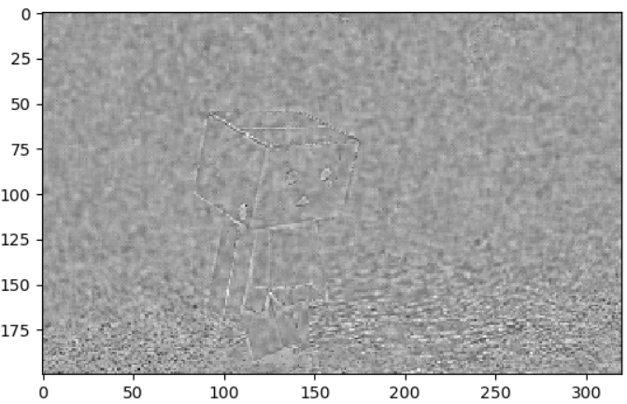
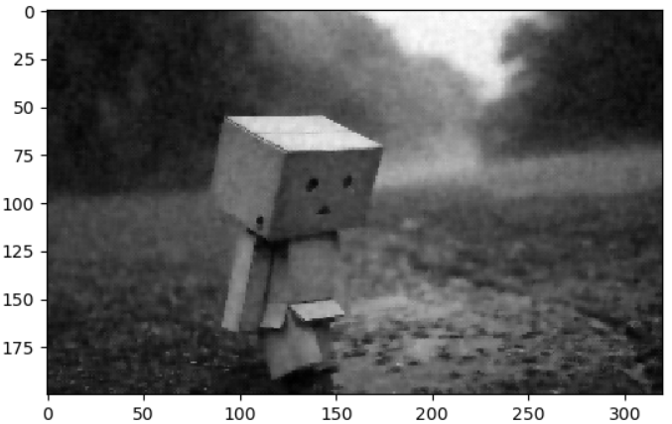
Denoising - Bilateral Filtering
MAE Mean: 0.0219
MAE Weighted Mean: 0.0193
MAE BF: 0.0180

Slide 17
Bi-Lateral Filtering- Demo
def bilateral():
img = cv2.imread('eye.jpg', cv2.IMREAD_GRAYSCALE) / 255.0
k2_size = 10
y, x = 300, 667
pivot_v = img[y, x]
neighbor_hood = img[
y - k2_size:y + k2_size + 1,
x - k2_size:x + k2_size + 1
]
sigma = .01
diff = pivot_v - neighbor_hood
diff_gau = np.exp(-np.power(diff, 2) / (2 * sigma))
gaus = cv2.getGaussianKernel(2*k2_size+1, k2_size)
gaus = gaus.dot(gaus.T)
combo = gaus * diff_gau
result = combo*neighbor_hood /combo.sum()

Slide 18
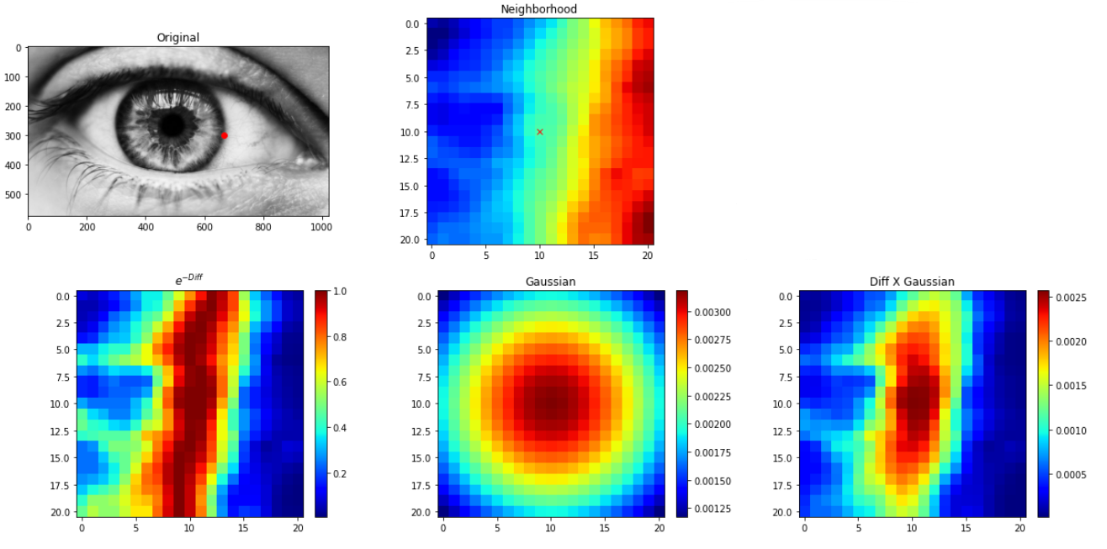

Slide 19
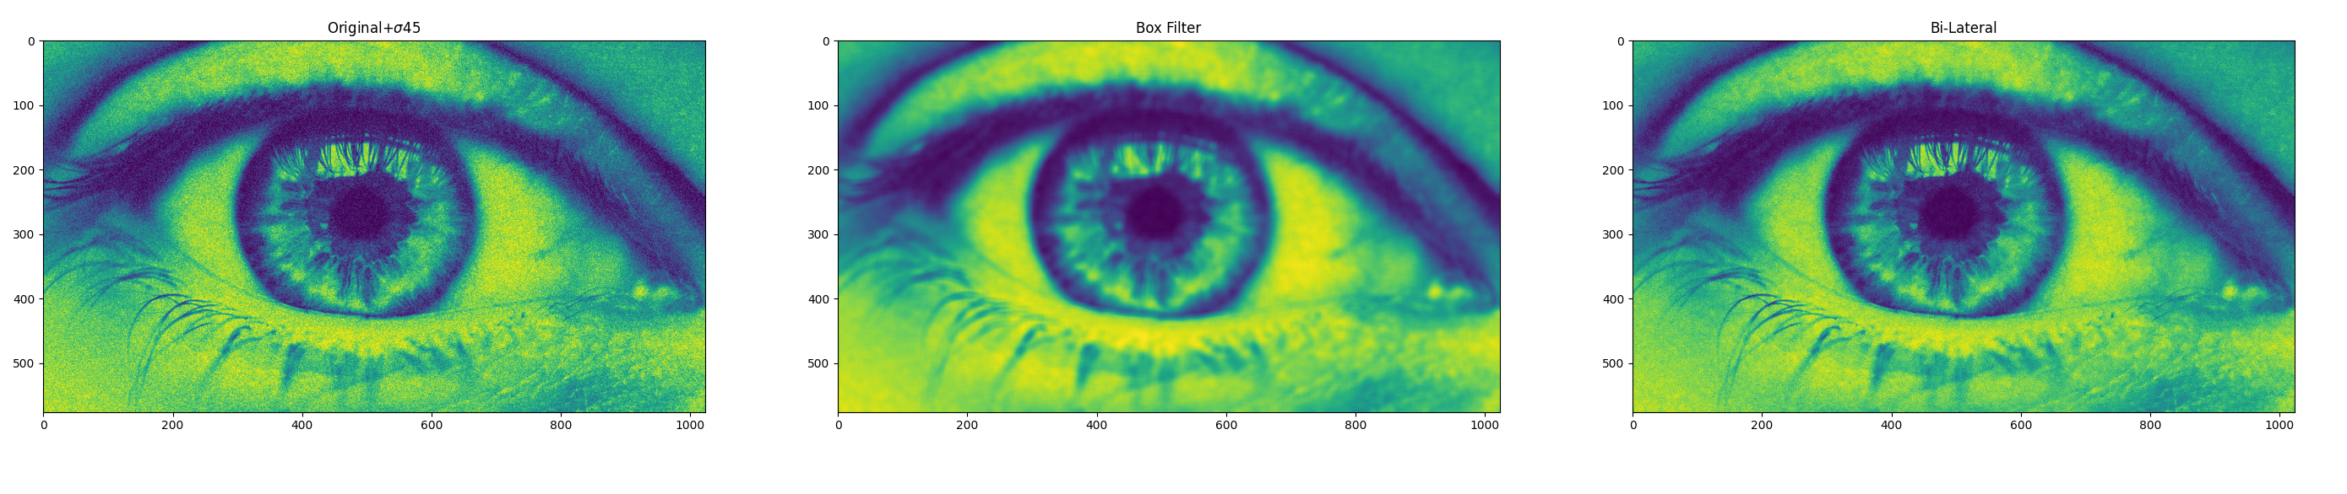
Bi-Lateral Filtering

